Slide 1
ONLINE SHOPPING CART
Utilizing Linked Lists and Time Functions
PRESENTED BY
K.SHASHANK-24KB1A3044
SK ADIL-24KB1A3094
SK IRFAN-24KB1A30A3
B GOPI KRISHNA-24KB1A3004

Slide 2
online shopping cart
In todays digital age,the online shopping cart plays a crucial role in enhancing the E-commerce experience .IT allows users to conveniently manage their selected items,view total costs including taxes and discounts,and proceed secure checkouts .
Online shopping carts are essential tools for e-commerce websites.
They allow customers to collect items they wish to buy and proceed to checkout seamlessly.
Convenient and user-friendly shopping experience.
Easy to review selected products.
Faster and secure checkout process.

Slide 3
INTRODUCTION
OBJECTIVE : Develop a console-based shopping cart system using c.
KEY FEATURES :
1.ADD ITEM TO CART
2.VIEW CART
3.REMOVE ITEM
4.UPDATE ITEM QUANTITY
5.CHECKOUT
6.EXIT
display current date during cart view and checkout.
calculate total amount and generate a receipt.
DATA STRUTURE USED:
singly linled list for dynamic item management

Slide 4
DATA STRUCTURE - CART ITEM
typedef struct CartItem
{
int id;
char name[50];
char category[30];
float price;
int quantity;
struct CartItem* next;
}
CartItem;

Slide 5
Fields Explained:
ID : Unique identifier for each item.
NAME : Name of the product.
CATEGORY : Category to which the product belongs.
PRICE : Price per unit of the product.
QUANTITY : Number of units added to the cart.
NEXT : Pointer to the next item in the cart (linked list implementation).

Slide 6
Creating and Adding Items
Function: create Item()
Allocates memory for a new item.
Initializes item details.
CartItem* createItem(int id, const char* name, float price, int quantity, const char* category);
Function: add Item()
Adds the new item to the beginning of the linked list.
void addItem(CartItem** head, int id, const char* name, float price, int quantity, const char* category);

Slide 7
Viewing Cart and Displaying Date
Function: viewCart()
Traverses the linked list and displays each item's details.
Calls printCurrentDate() to show the current date.
void viewCart(CartItem* head);
Function: printCurrentDate()
Utilizes <time.h> to fetch and display the current date.
void printCurrentDate();

Slide 8
Checkout and Total Calculation
Function: calculateTotal()
Calculates the total amount by summing up the product of price and quantity for each item.
float calculateTotal(CartItem* head);
Function: checkout()
Displays the final receipt with all item details and the total amount.
Calls printCurrentDate() to display the date.
Calls clearCart() to empty the cart after checkout.
void checkout(CartItem* head);

Slide 9
INPUT
1 - add an item
103 - id of an item
Apples -item name
Fruits - category
15.0 - prize of an item
6 - quantity
1 - add an item
245 - id of an item
Chocolate - item name
Sweet - category
100.0 - prize of an item
1 - quantity
2 - view the cart
3 - remove an item
103 - id of an item
5 - check out
6 - exit

Slide 10
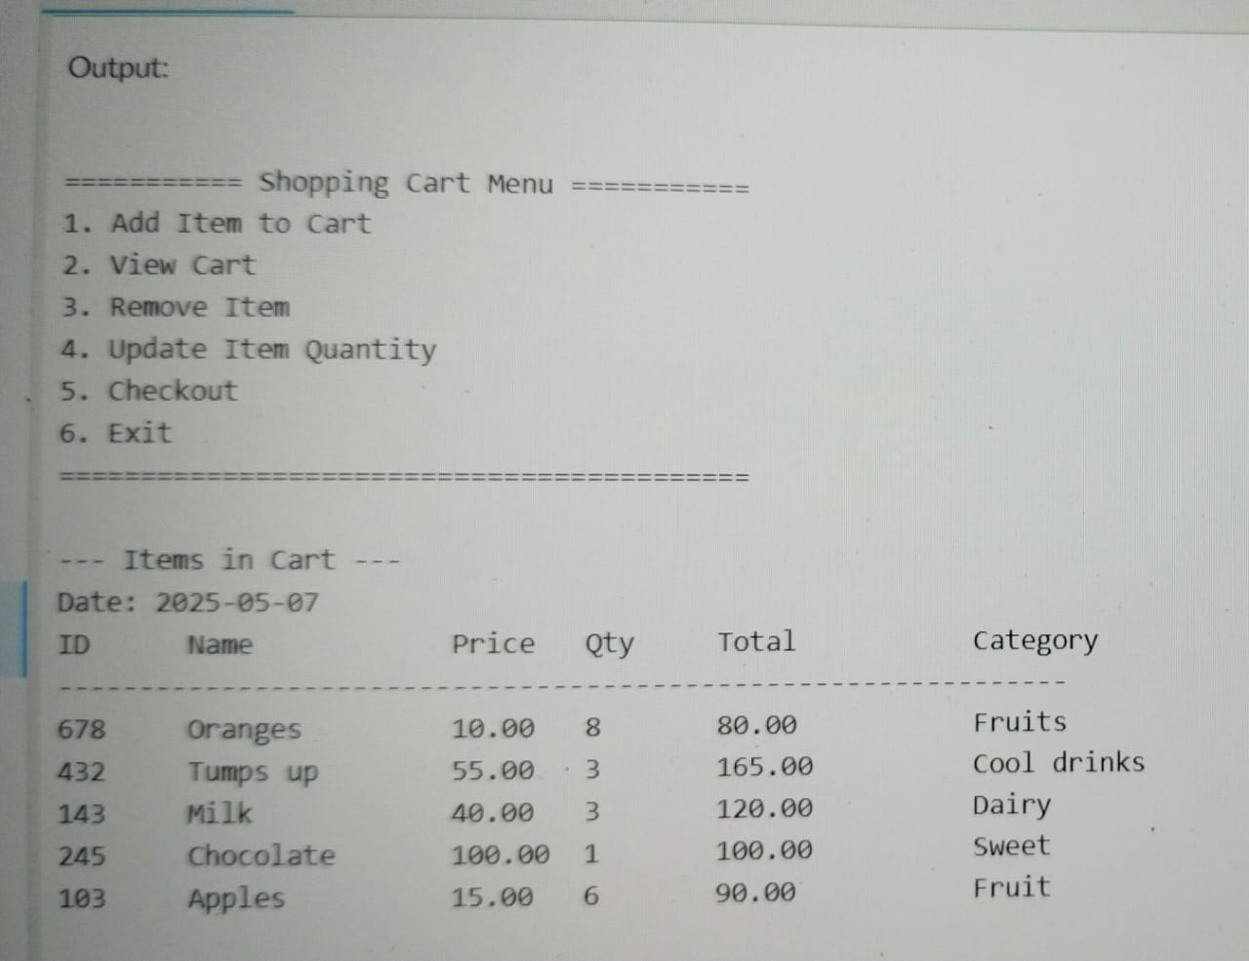
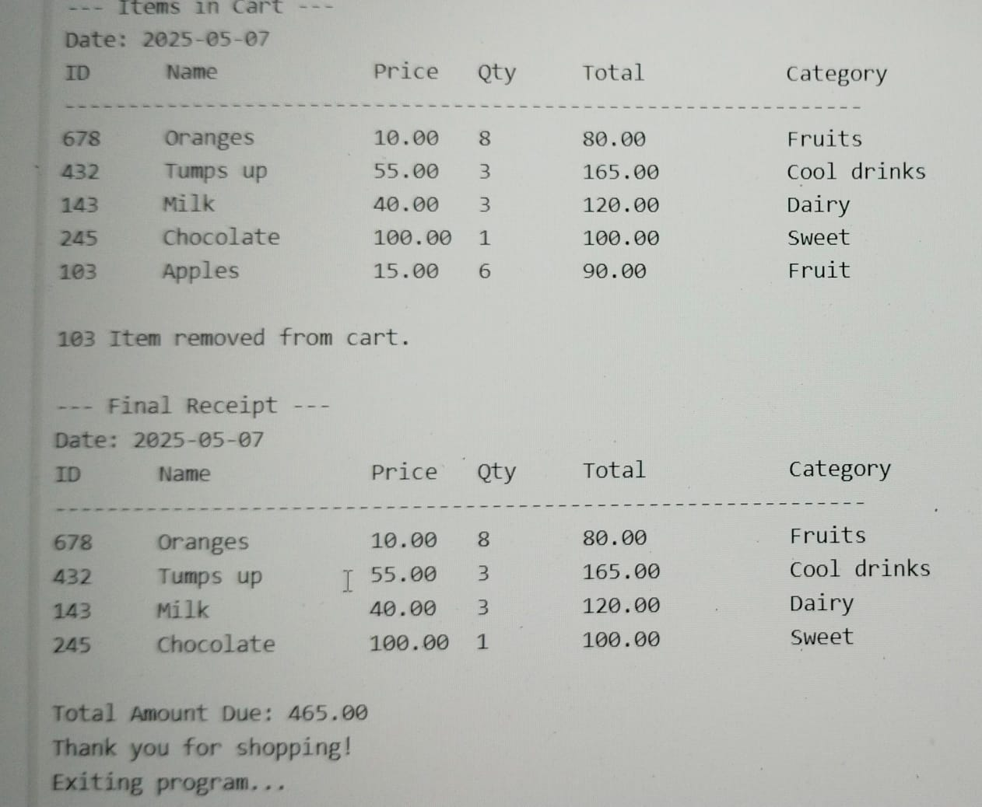
SAMPLE OUTPUT SCREENS

Slide 11
Conclusion
Efficient management of shopping cart using linked lists.
Modular code with clear separation of concerns.
User-friendly interface with clear instructions.
Future Enhancements:
Implementing of payment systems
Adding search functionality by item name or category.
Applying discounts and promotional offers.
Displaying time

Slide 12
thank you

